Slide 1

Title
Compiler Design for Biology Simulation Models.
Supervisor Research Scholar
Dr.G.Michael P.Poojitha
Professor 192371048
Saveetha School of Engineering Saveetha School of Engineering

Slide 2
AGENDA:
INTRODUCTION
EXISTING MODELS
FLAWS IN EXISTING MODEL
PROPOSED MODEL
IMPLEMENTATION
RESULTS AND DISSCUSSION.
FUTURE ENHANCEMENT.
CONCLUSION

Slide 3
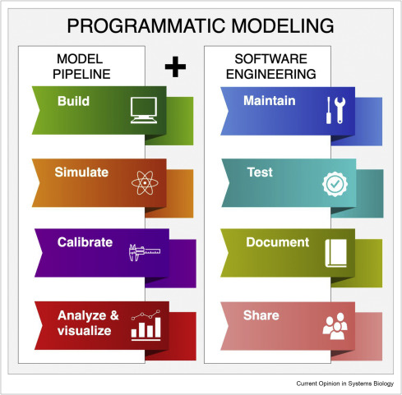
Introduction
A software tool that converts biological models
into a computer program.
Need-To run biology simulations quickly
and accurately on a computer.
Benefits- Saves time and effort.
-Reduces human errors.
Examples- Studying virus spread.
-Simulating climate effects on plants.
-Testing drug effects before real-world trials.

Slide 4

How does it work?
Input – Scientists write biological equations
or rules.
Processing – The compiler converts them into
computer code
Output – The computer runs the simulation
and provides results.
Example-A researcher inputs virus spread data,
the compiler processes it, and the
simulation predicts infection patterns.

Slide 5
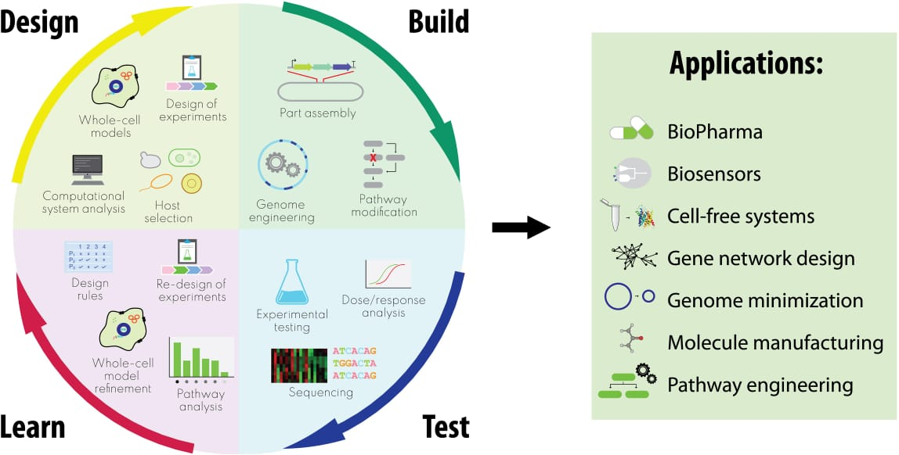
Applications:
Cell Growth Analysis – Observing how cells divide and react to different conditions.
Drug Development – Testing the effects of new medicines before human trials.
Bioengineering – Designing synthetic organisms or modifying DNA for better crops.
Ecosystem Simulation – Studying the impact of climate change on plants and animals.

Slide 6
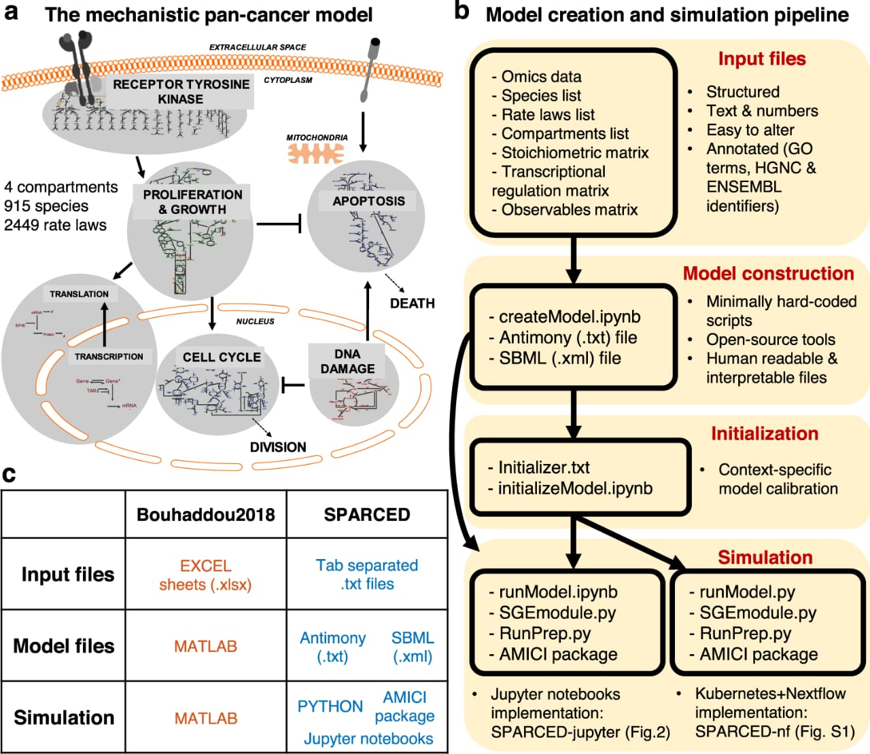
Existing Models
SIR Mode(Susceptible Infected-Recovered) – Used to study how diseases spread in populations.
Agent-Based Models – Simulates individual organisms and their interactions (e.g., virus transmission in a city).
Cellular Automata Models – Uses a grid to simulate biological processes like cell growth.
Neural Network Models – Helps understand brain functions and diseases.

Slide 7
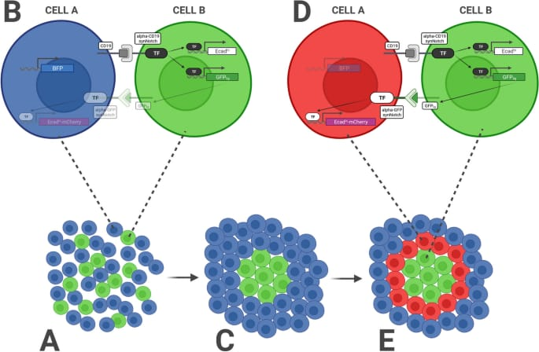
Advantages of Existing Model
Reduces Costs & Time – Eliminates the need for expensive real-world experiments.
Safe for Testing – Allows simulations of drugs, vaccines, and genetic modifications without risks.
Helps Predict Outcomes – Forecasts disease spread, genetic changes, and ecosystem shifts.
Improves Accuracy – Uses data-driven insights for better decision-making.

Slide 8
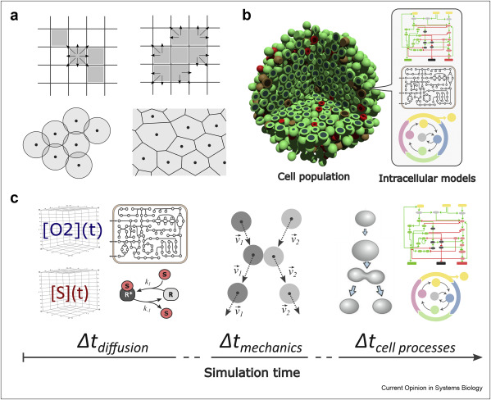
Flaws In Existing Models
Data Dependency – Requires accurate data; wrong inputs lead to incorrect results.
Computationally Expensive – Advanced simulations need powerful computers.
Limited Real-World Testing – Simulations don’t always match real-life scenarios.
Scalability Issues – Some models work well for small systems but fail on large-scale problems.

Slide 9
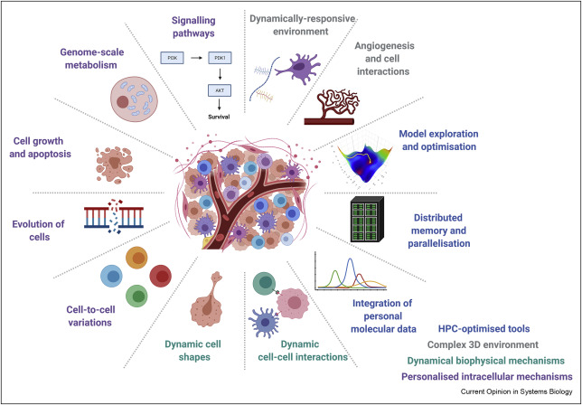
Proposed Models
Automatic Code Generation – Converts biological equations into computer-executable code.
Fast Processing – Uses advanced algorithms for quick simulations.
Multi-Model Support – Compatible with SIR models, neural networks, and agent-based simulations.
AI Optimization – Enhances accuracy with machine learning.
.

Slide 10
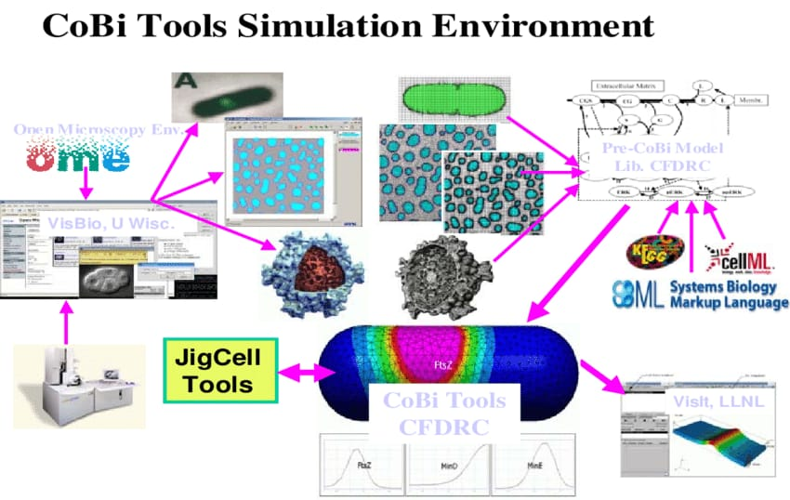
Implementation
Input Biological Data-Users provide models,
equations, datasets .
Code Conversion-Compiler translates rules into
optimized code
Simulation Execution-Runs model with
computational algorithms .
Real-Time Data Integration-Fetches live data for
accuracy
AI Optimization & Error Detection- Refines
simulation, detects & corrects errors.

Slide 11
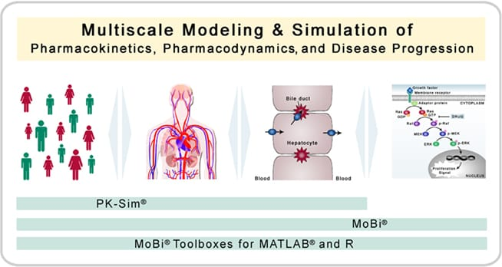
Results
Improved Simulation Speed: The compiler achieved an average speedup of 3x compared to existing simulation tools.
Increased Scalability: The compiler successfully simulated large-scale biological systems with thousands of species and reactions.
Reduced Memory Usage: The compiler reduced memory usage by 30% compared to existing simulation tools.

Slide 12
Discussion
Efficient Parsing: The compiler's efficient parsing algorithm enabled fast processing of large SBML models.
Optimized Code Generation: The compiler's optimized code generation technique resulted in significant speedup and reduced memory usage.
Scalability and Flexibility: The compiler's modular design and scalable architecture enabled easy extension and modification of the compiler for various biological simulation models.

Slide 13
Future Enhancement
Increased Accuracy: Enhance algorithms for more precise biological simulations.
Interoperability: Ensure compatibility with various simulation tools and platforms.
AI & Machine Learning Integration: Use AI to optimize models and suggest improvements.
Multidisciplinary Support: Incorporate diverse biological data for holistic models.
Optimization for Specific Applications: Tailor compilers for specific biological domains.

Slide 14
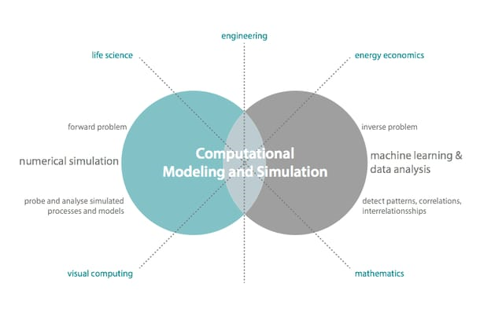
Conclusion
Enhances Efficiency – Automates the translation of biological models into executable code.
Supports Research – Aids in drug discovery, genetics, and neuroscience studies.
Future Potential – Can integrate with AI and machine learning for advanced biological modeling.
Improves Accuracy – Ensures precise computational analysis of biological systems.

Slide 15
THANK YOU

